Slide 1



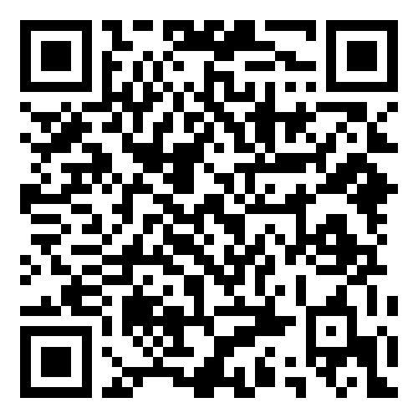
WELCOME TO
The NHS Telemedicine Conference 2022
3rd November 2022- 08:00am – 15:30pm – Hatfield’s Conference Centre
Conference hosted by Convenzis Group Limited

Slide 2
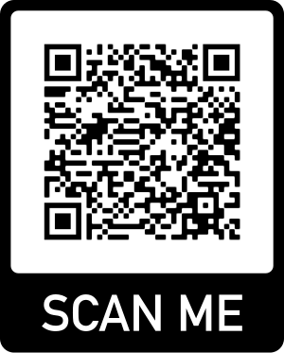
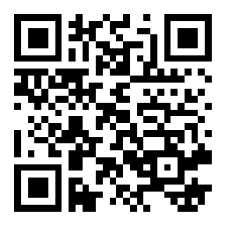
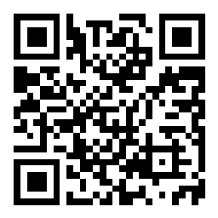
Slido
Please scan the QR Code on the screen. This will take you through to Slido, where you can interact with us.
3rd November 2022- 08:00am – 15:30pm – Hatfield’s Conference Centre
Conference hosted by Convenzis Group Limited

Slide 3
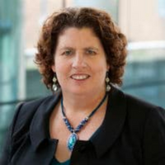
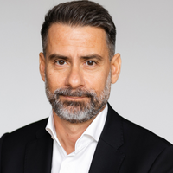
The NHS Telemedicine Conference 2022
Event Chair – Opening Address
Dr. Dimitris Kalogeropoulos
Senior Independent Adviser, Global Health Innovation Expert
WHO, World Bank, European Commission, UNICEF, Healthcare Industry

Slide 4
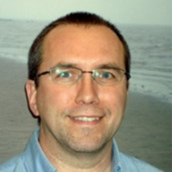
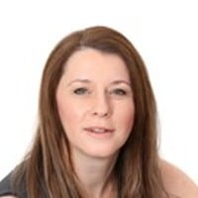
The NHS Telemedicine Conference 2022
SPEAKING NOW
I will be discussing…
“Enhancing the adoption of digital technologies in health and care workforce education and training”
Professor Bryn Baxendale
Clinical Advisor and Lead, Simulation and Immersive Learning Technologies HEE Technology Enhanced Learning Programme
Health Education England

Slide 5
Slido
Please scan the QR Code on the screen. This will take you through to Slido, where you can interact with us.
3rd November 2022- 08:00am – 15:30pm – Hatfield’s Conference Centre
Conference hosted by Convenzis Group Limited

Slide 6
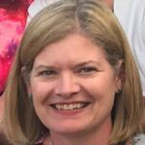
The NHS Telemedicine Conference 2022
SPEAKING NOW
I will be discussing…
“Best Practice Session (Digital Care Hub)”
Rachel Binks
Nurse Consultant, Digital and Acute Care and Clinical Lead for the Digital Care Hub - Airedale NHS Foundation Trust

Slide 7
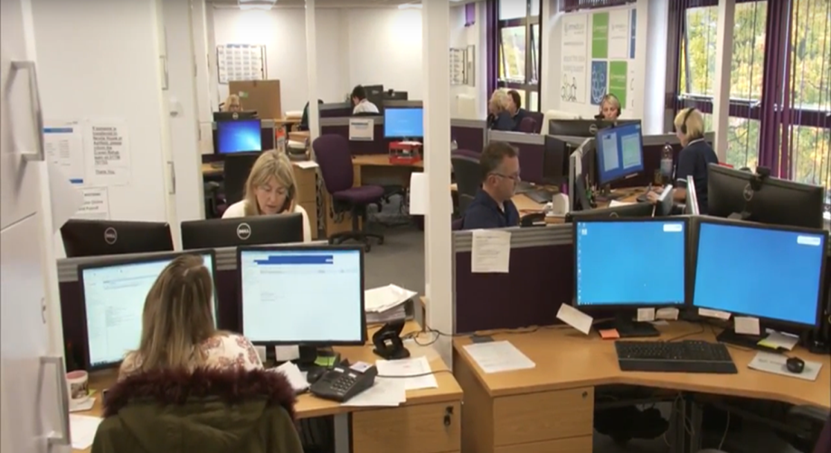
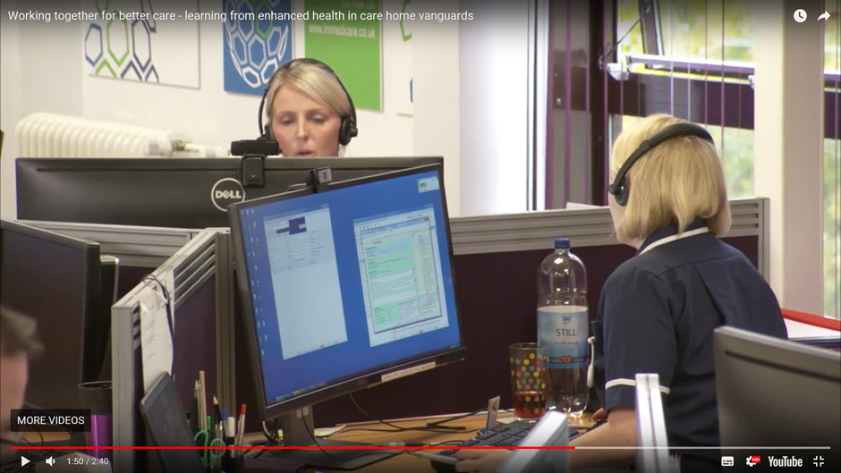

Digital innovations/Remote monitoring
Rachel Binks
Nurse Consultant
Digital & Acute Care
rachel.binks@nhs.net

Slide 8






Where have we come from?
A long and successful history of digitising patient services
CO@Home
Covid Virtual Ward
Digitised patient services established at Airedale
COPD & pneumonia Virtual Ward
2006
2010
2012
2007
2007
2008
2009
2011
2013
2014
2015
2016
2017
2018
2019
2020
2021
2022
Rapid scaling of
COPD service
Several small-scale pilots funded via innovation grants

Slide 9

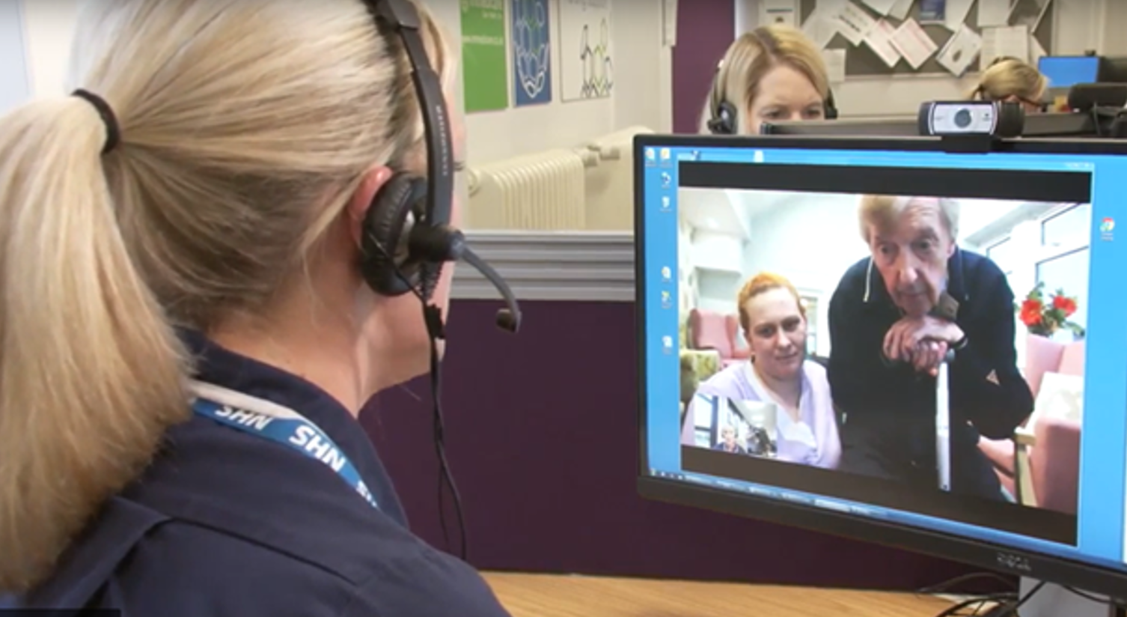
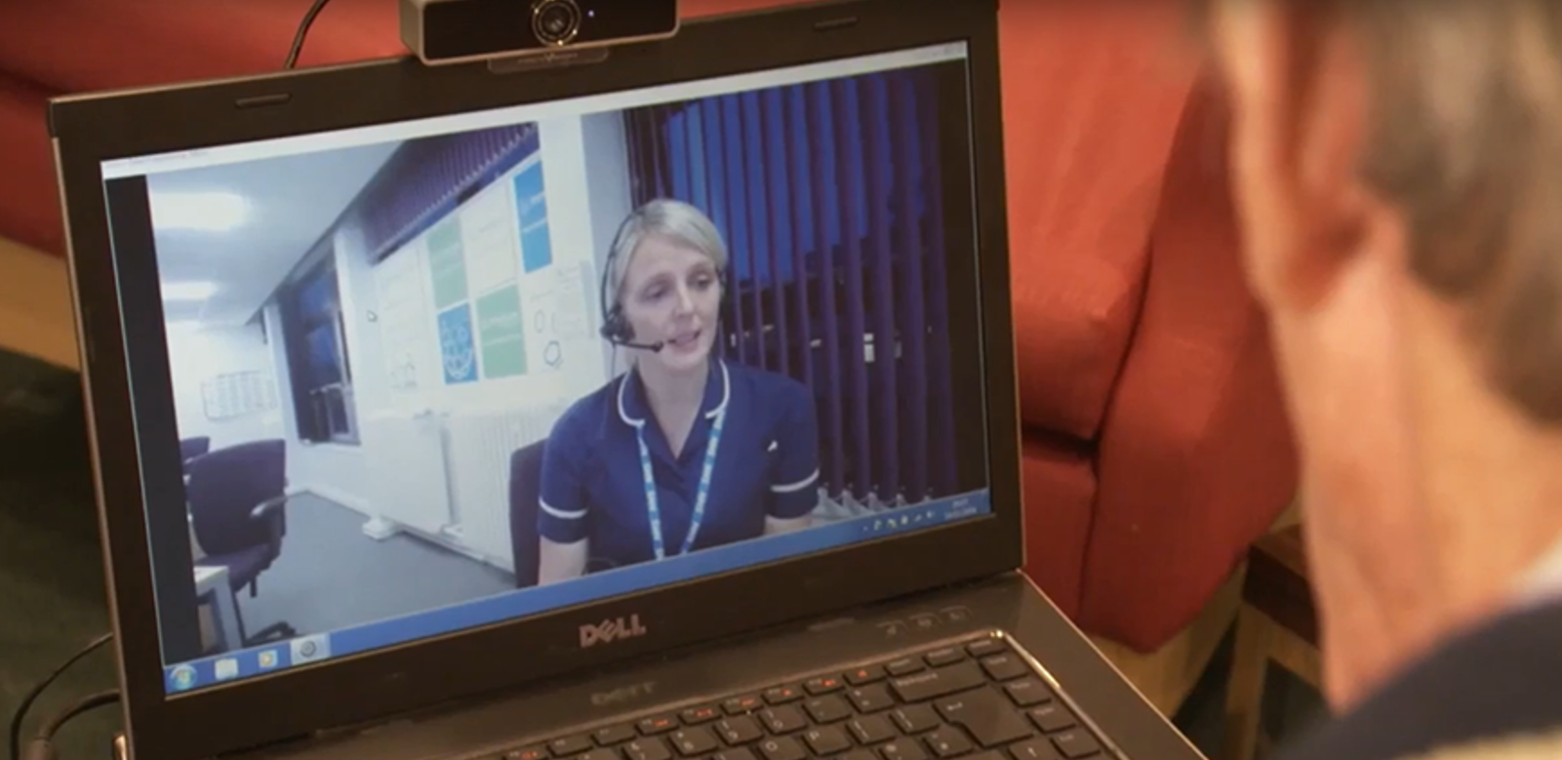

Digital Care Hub - Services Delivered
Teleconsultation
Electronic Patient Record
Registered Practitioners
Video Assessment
24/7 clinical hub
improving patient experience
changing patient flow
reducing costs

Slide 10
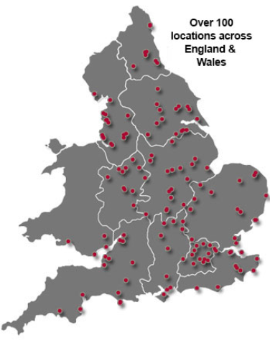
Offender Health Telemedicine Service
2007 - prison telemedicine service started
2022 – grown to 44 prisons/young offenders institutes
A third of the UK prisons
Mix of consultant, therapy and specialist nursing services
Dedicated admin team
Account manager
Prisons/YOIs served by Airedale
Other Prisons/YOIs

Slide 11
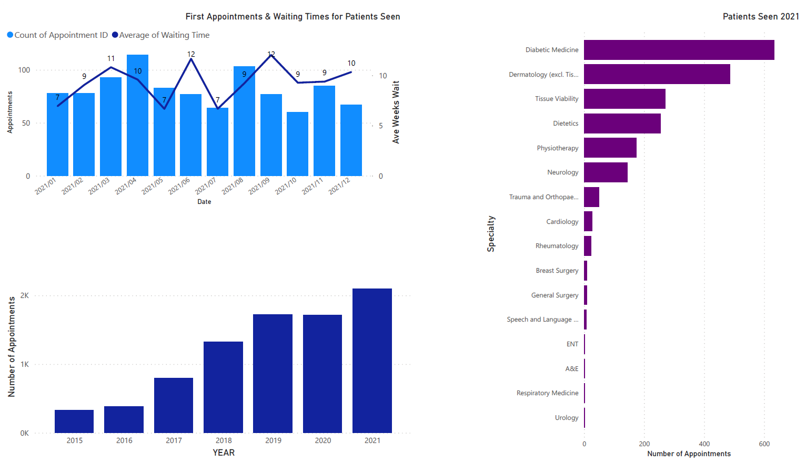
Prison Data
Average of over 100 referrals per month in 2021
Low waiting time for first appointment (7 & 12 weeks)
>2000 patients seen in 2021

Slide 12
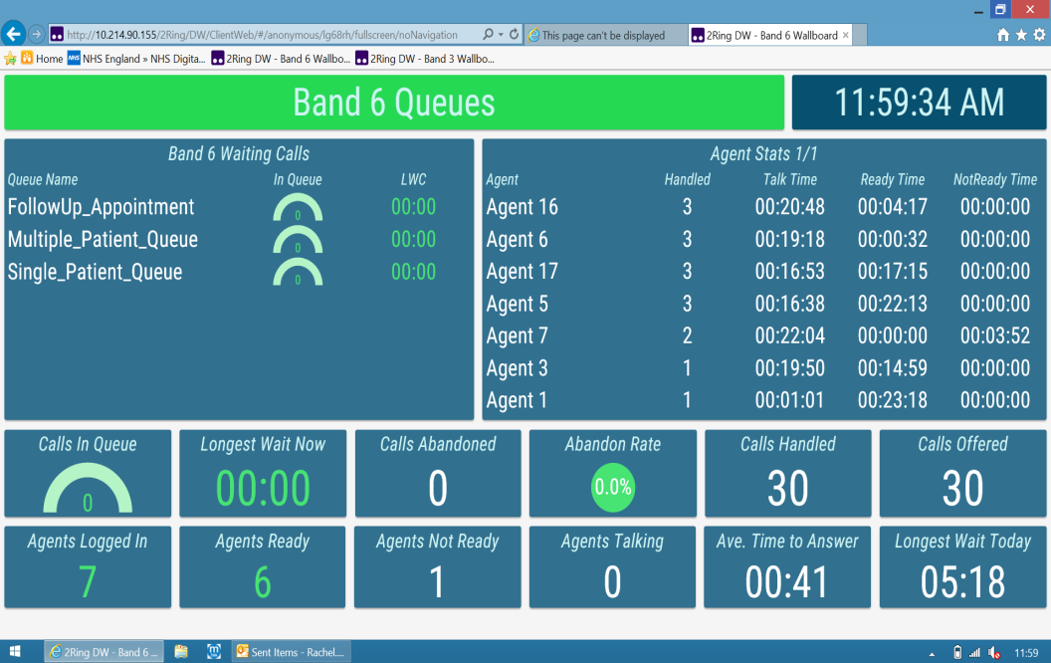
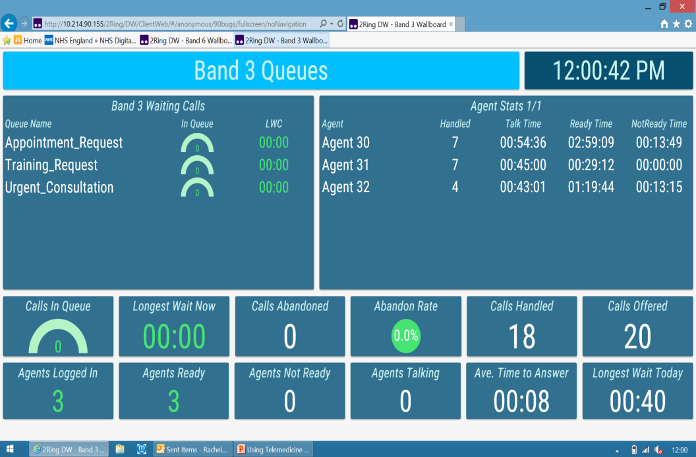
Wall Boards

Slide 13
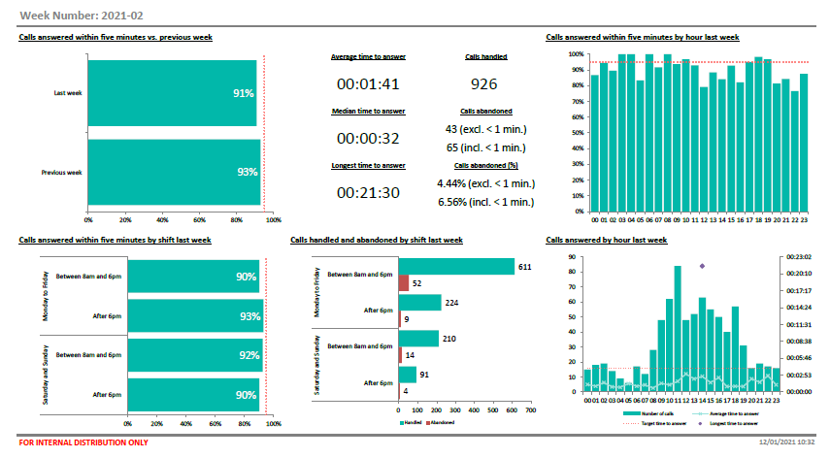
Weekly KPIs

Slide 14

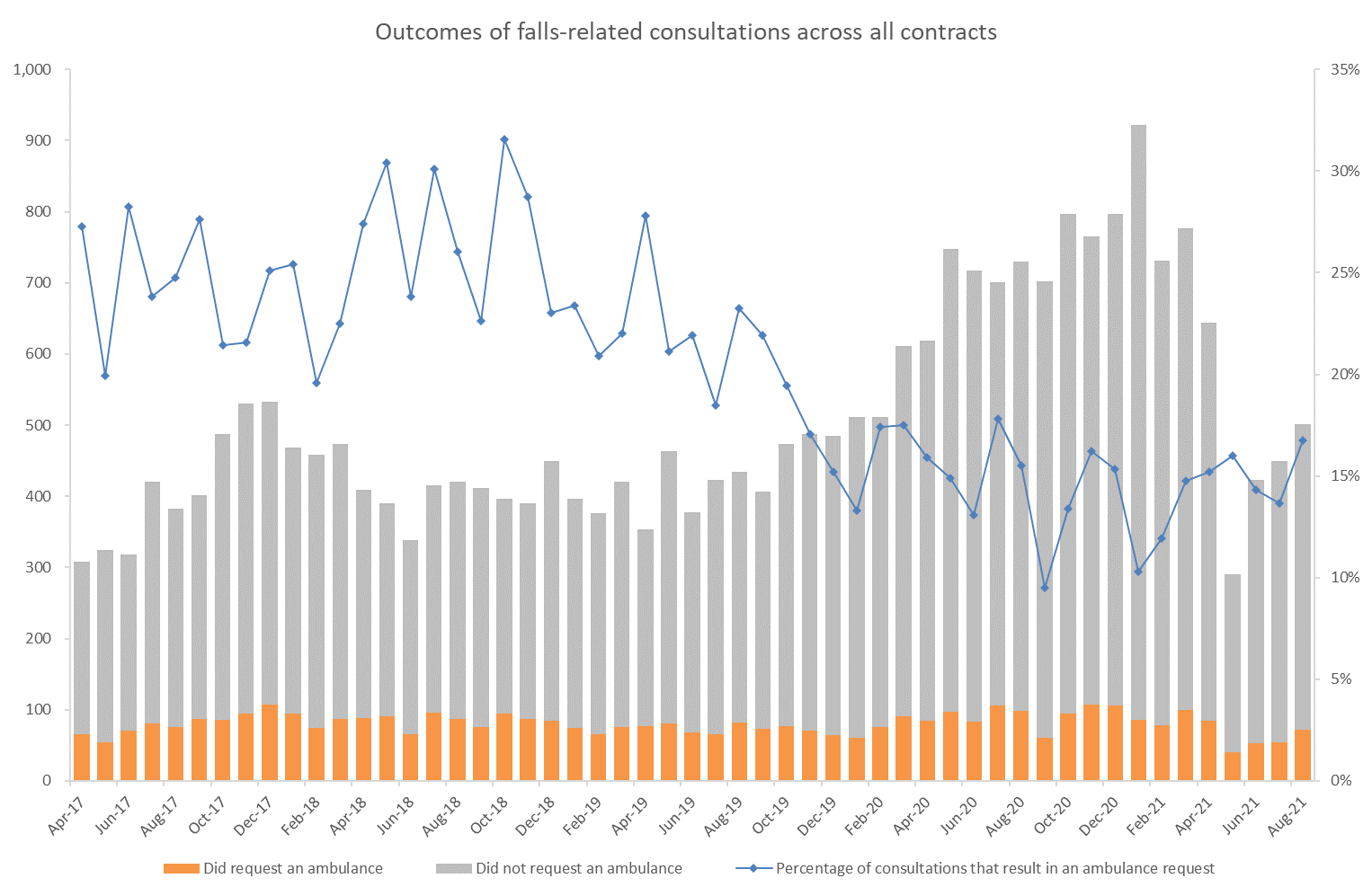
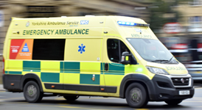
Our Impact: Care Homes
24/7 clinical support for care home residents and staff, delivered via secure video link since 2013.
3000 calls per month (2020/2021 FY)
91% of patients remain in place of residence
60 % require no onward referral
>800 homes at pandemic height
“Telemedicine is brilliant, the staff are always using it, I hardly get any phone calls during the night, as I used to, staff would be lost without it’’
Care Home Manager
“The greatest change in 15 years to reduce workload” GP
Notes:
Remote – removing risk of spread of covid in vulnerable patients.

Slide 15
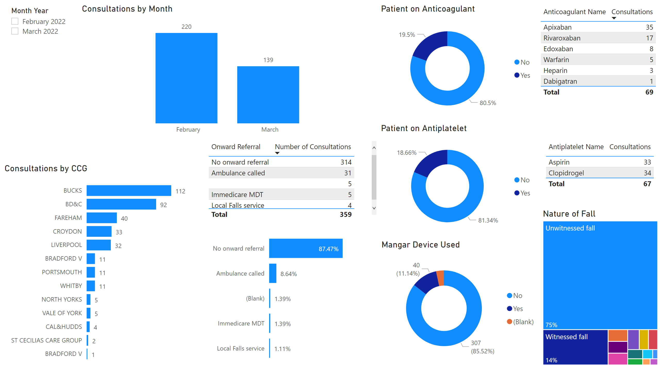
Page 1
Falls data
Notes:
slicer
No alt text provided
Consultations by Month
No alt text provided
Patient on Anticoagulant
No alt text provided
tableEx
No alt text provided
Patient on Antiplatelet
No alt text provided
tableEx
No alt text provided
Mangar Device Used
No alt text provided
Consultations by CCG
No alt text provided
Nature of Fall
No alt text provided
Onward Referral
No alt text provided
tableEx
No alt text provided

Slide 16
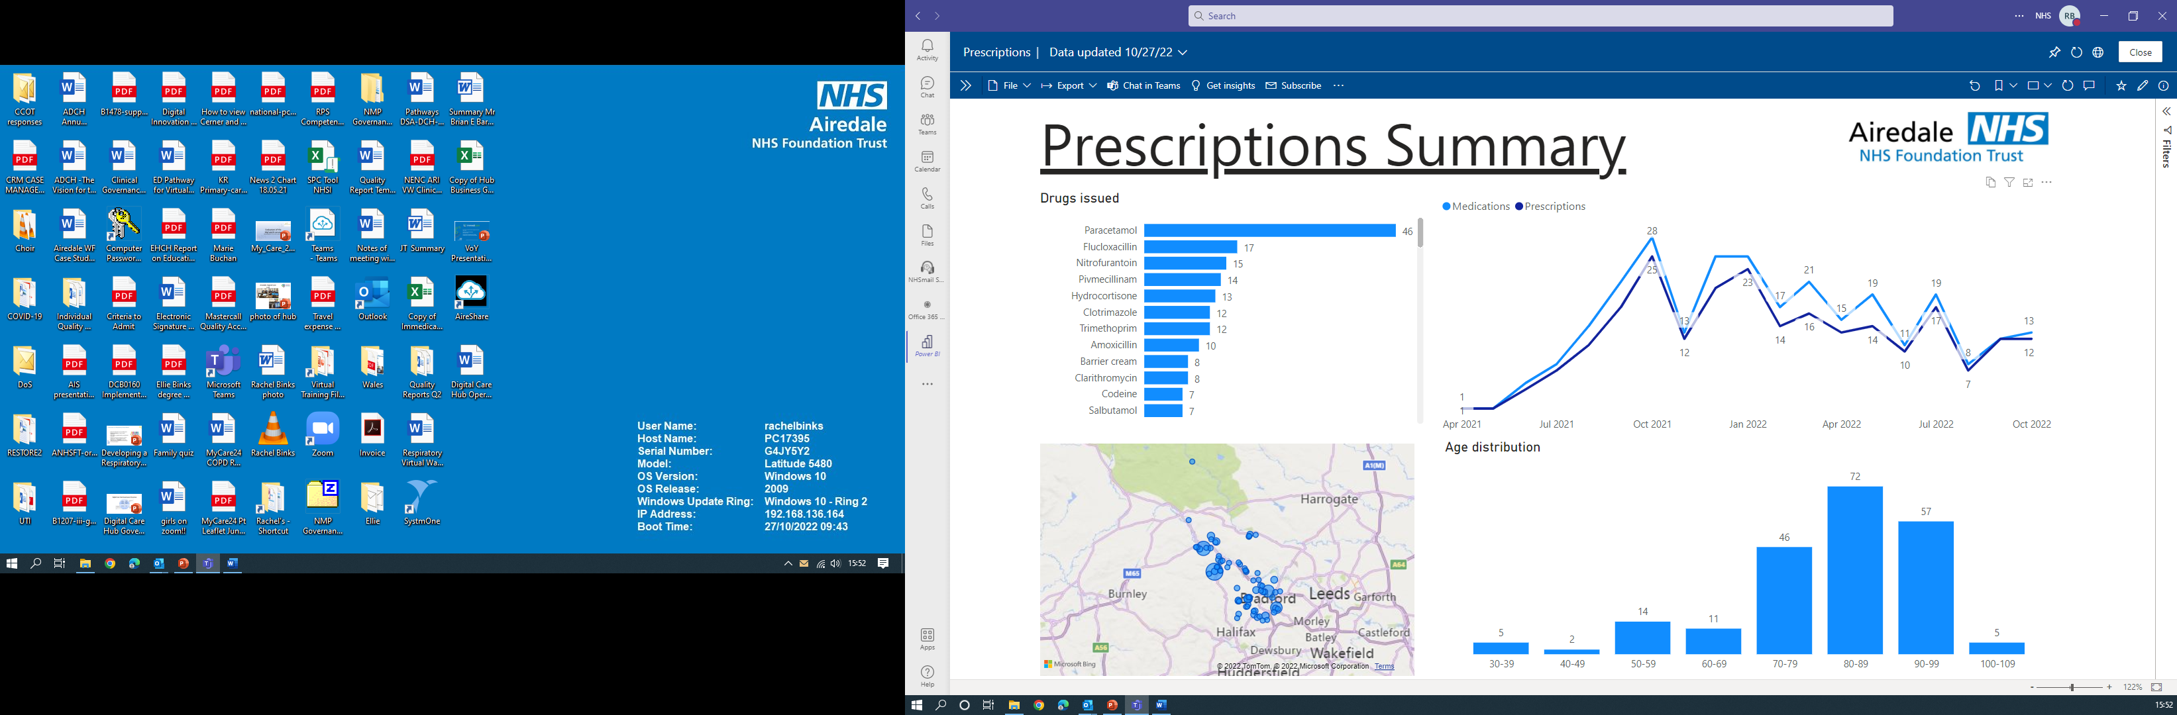
Prescriptions Issued

Slide 17
Remote Devices

Slide 18
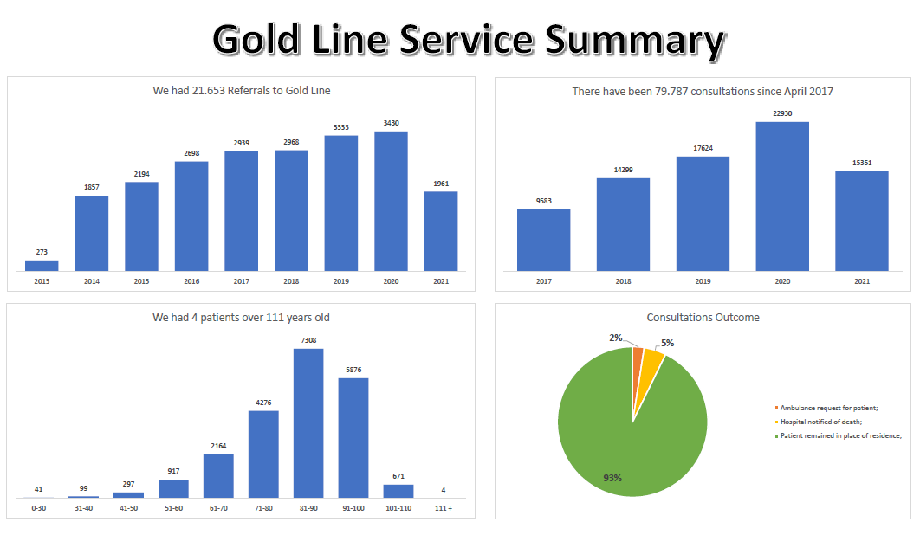
Goldline Data

Slide 19

Our Impact: Goldline
Helping patients to die on their own terms in
the place of their choosing
only13% of deaths occurred in hospital (45% England av. 19/20) | 23% reduction in unplanned admissions, saving £2 for every £1 spent
66% of calls received out of hours, providing vital round the clock support | 43% not known to specialist palliative care teams: reducing inequalities in end of life care.
“To all staff working on Goldline - You are the most amazing team who were there for us at the most difficult time. You supported us to take our dad and care for him at home during the last days of his life, which is the most precious gift.”

Slide 20
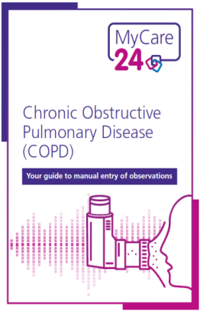
MyCare24 COPD
MyCare24 COPD pilot from 50 to 6000 patients
Remote monitoring via an App (or paper alternative) used by the CO@H and VW
24/7 access to a qualified health care professional (DCH) for patients living in their own homes with moderate/severe/very severe COPD
Bradford District and Craven (BDC) Place
Support to proactively manage their condition keeping them ‘happy and healthy at home’
Reduce dependence on stretched health care services
Realise the patient and system benefits
Embed and evaluate the impact at scale

Slide 21
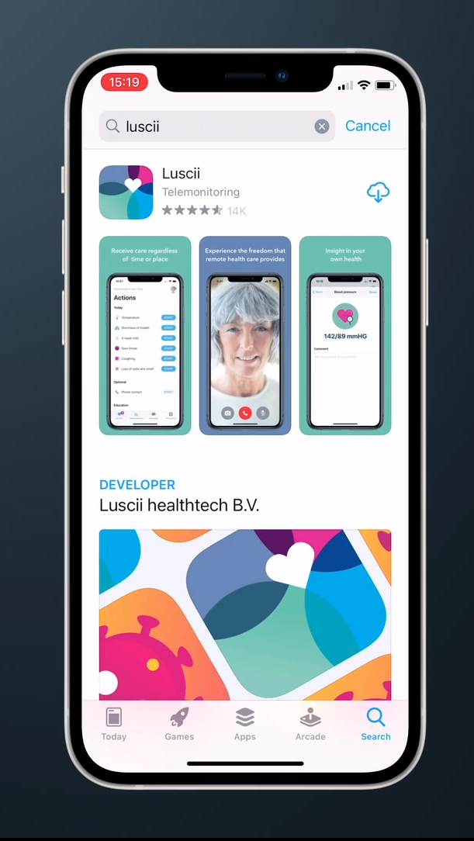
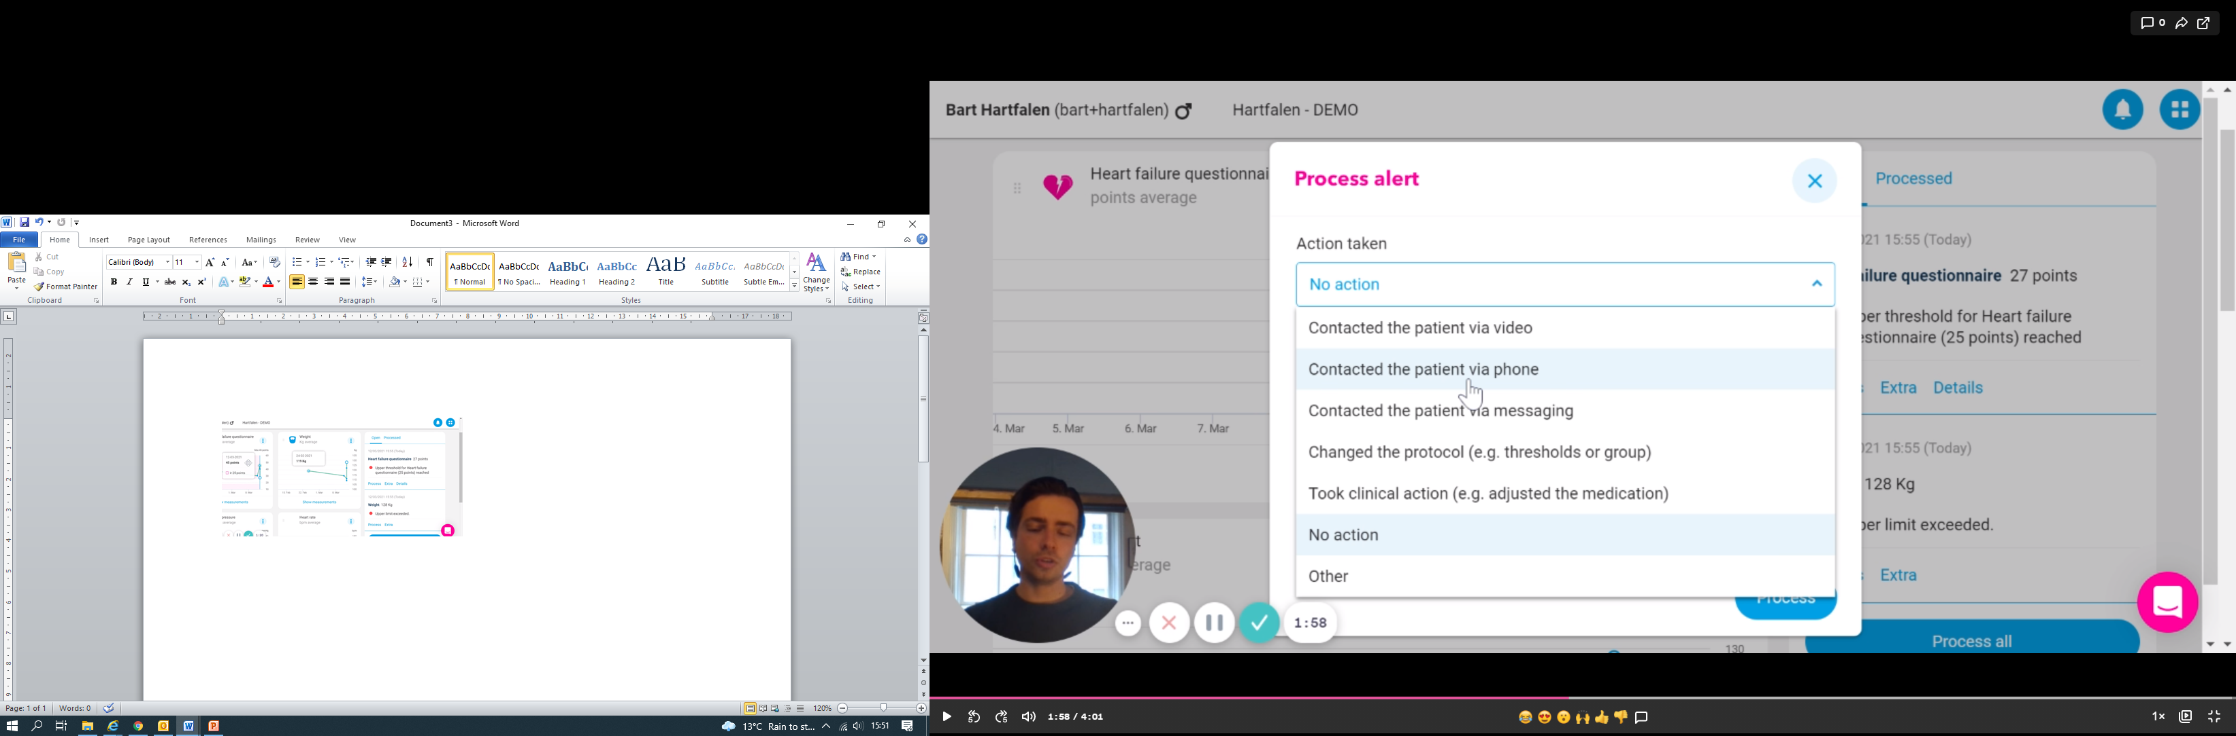
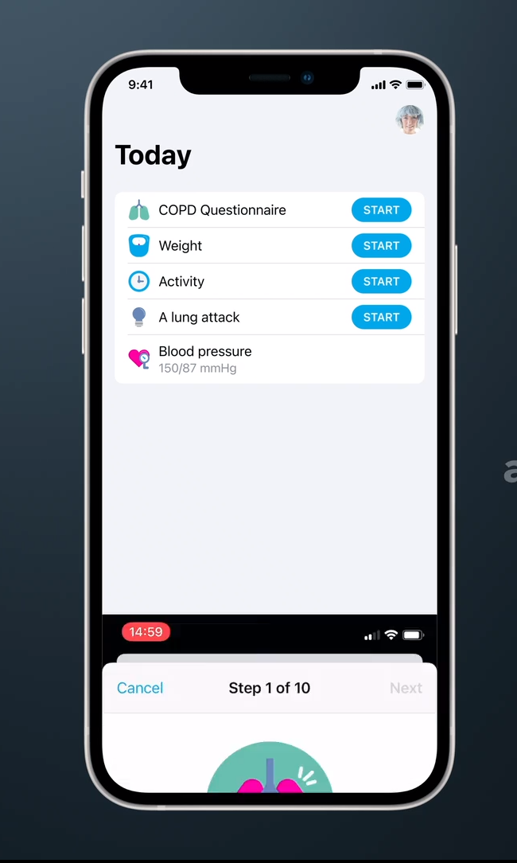
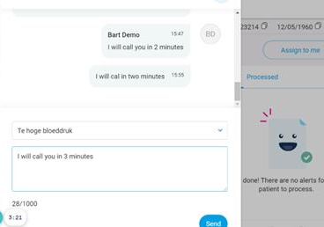
Patient view of App

Slide 22
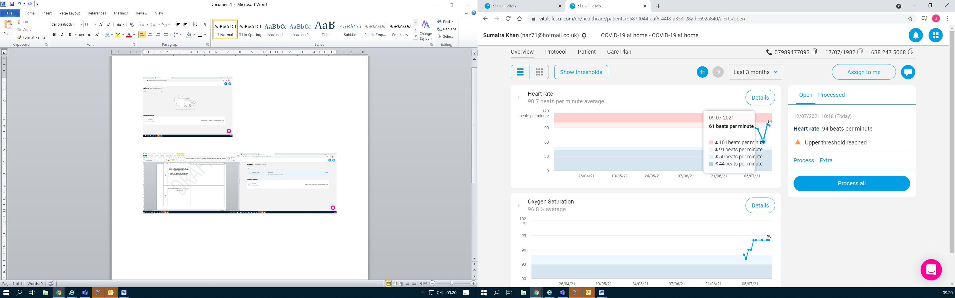
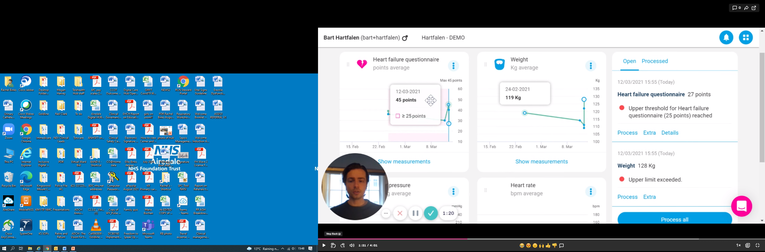
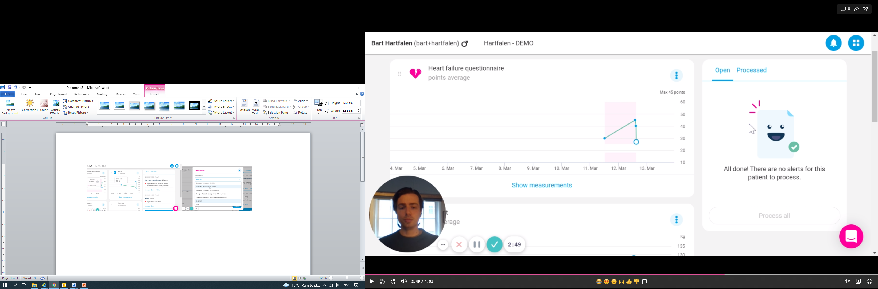
MyCare24 – Clinical view
Supporting patients with COPD at home: right care, right time, right place
Monitoring, especially via the App, helps us understand a patient’s condition allowing early identification and intervention if required.

Slide 23
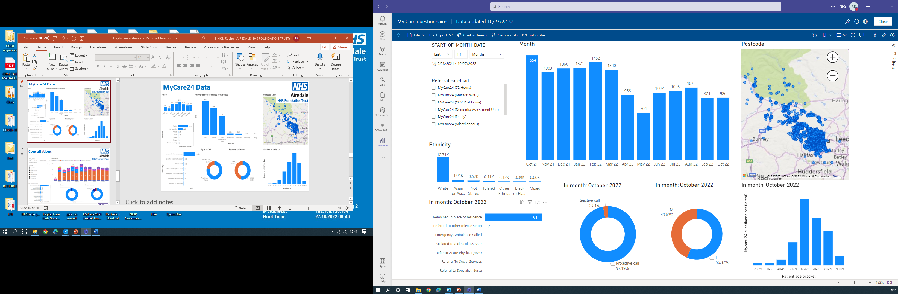
MyCare24 Data

Slide 24
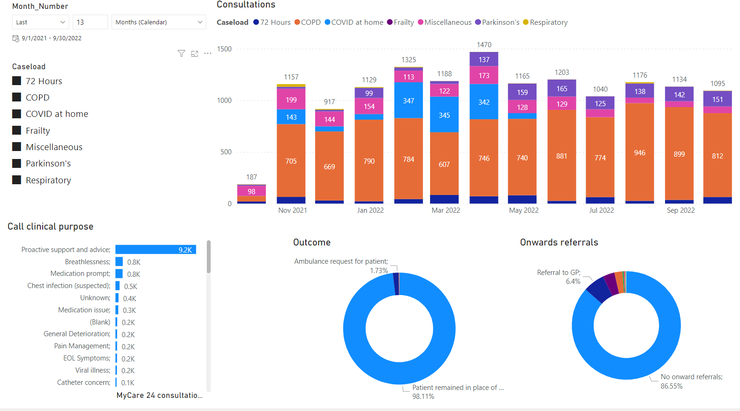
MyCare24 Consultations

Slide 25
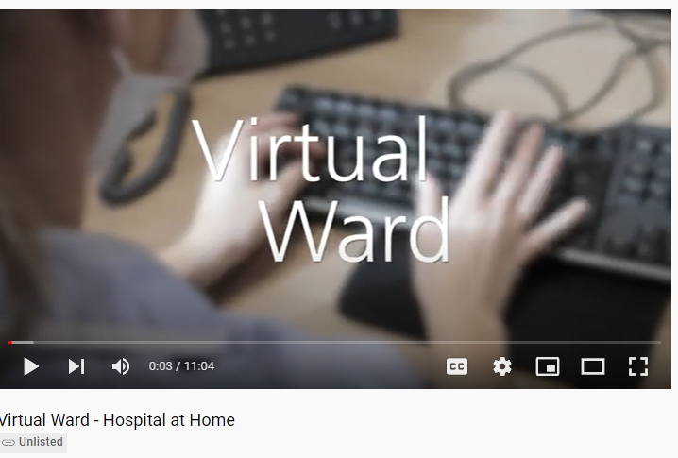
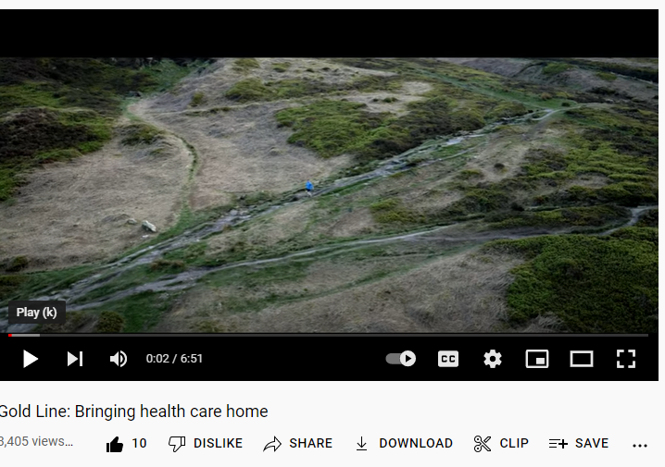
Videos
Virtual Ward - Hospital at Home – YouTube
Gold Line – https://www.youtube.com/watch?v=nH1cM-Jc8Zs

Slide 26


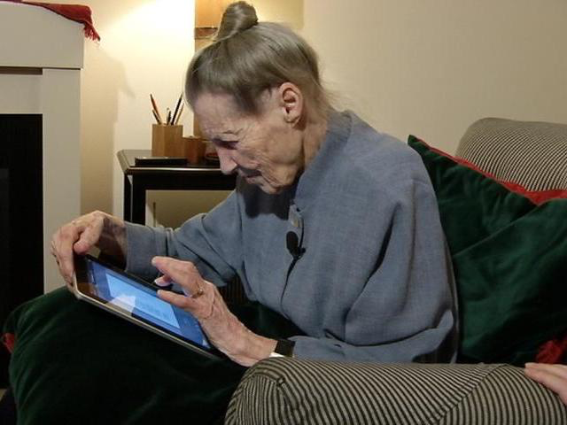


Ambition
End of Life/Virtual Ward
COPD/Frailty/Heart Failure/Parkinson's etc
CO@Home/CVW/ Care Homes
Empowering patients and carers to manage their conditions at home
Building system resilience
Protecting our environment
Notes:
This is a bit of a summary of impact for BDC at helicopter view level – would be good to focus discussion on system resilience
Empowering patients and carers to manage their conditions at home
Support to self-care, educating where appropriate
24/7 access to the right care and support, at the right time
Early identification and timely intervention to prevent escalating conditions
Building system resilience
Protecting services from avoidable demand
Reducing costs
Strengthening community response for complex cases
Improving flow
Retaining valued clinical expertise
Lisa’s recent discussion with Prac Man: General Practice at the moment is very demoralised and is having a real bashing in the media and this PM has been in GP for over 20 years. When I explained the service and what we were hoping to achieve, not just for COPD but for future services she said ‘she was only saying to the lead nurse the other day, that she is worn down and had enough and is thinking of packing in the role but listening to me and taking the time to visit City practices to discuss this new service has given her enthusiasm that there is light at the end of tunnel for patients and the NHS and has fired her up again’
Protecting our environment
Reducing travel for patients and staff

Slide 27
Questions?

Slide 28
Slido
Please scan the QR Code on the screen. This will take you through to Slido, where you can interact with us.
3rd November 2022- 08:00am – 15:30pm – Hatfield’s Conference Centre
Conference hosted by Convenzis Group Limited

Slide 29
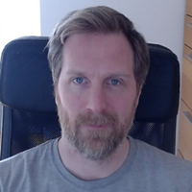
The NHS Telemedicine Conference 2022
SPEAKING NOW
I will be discussing…
“Digitally Enhance Remote Support for Long Covid Clinics”
Dr Goodfellow
NIHR clinical lecturer in digital health and primary care
UCL

Slide 30


Creating a Digital health intervention for post covid clinics
Dr Henry Goodfellow
NIHR clinical lecturer in primary care and eHealth
eHealth Unit, UCL

Slide 31
Todays talk
Background
2. About the digital Health intervention
3. Variations in use
4. Important lessons

Slide 32
My interest
How can we best use the power of digital in the healthcare setting?
We can
Improve care
Save money through optimisation
Reduce health inequalities
Improve patient experience
Can to normalise use of digital tools similar to other sectors such as travel, banking and shopping

Slide 33
Background
NIHR grant which started in September 2020
Design a DHI to provide digitally enhanced remote support for Long Covid patients
2. Deploy widely across the NHS
3. Evaluate for user acceptability and cost effectiveness

Slide 34
Our MDT team
Academics:
Digital Health design, Computer processing, Human Behaviour, social, implementation science,
Clinicians:
5 Respiratory consultants, 2 physiotherapists, psychologist, 3 GPS
PPI:
Core members Julia and Belinda.
20 additional members recruited
Industry:
Living With - software design & dev, existing platform, modules from other conditions

Slide 35
DHI
Three interconnected
parts
Patient facing App
Clinician Digital dashboard
Clinical pathway

Slide 36
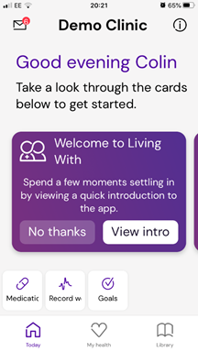
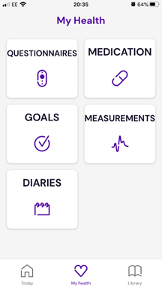
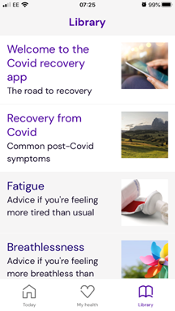

Slide 37
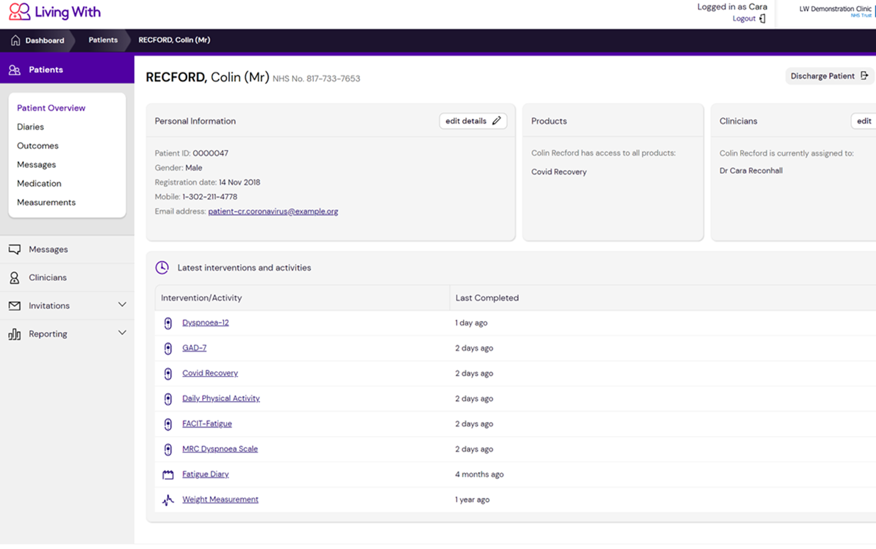
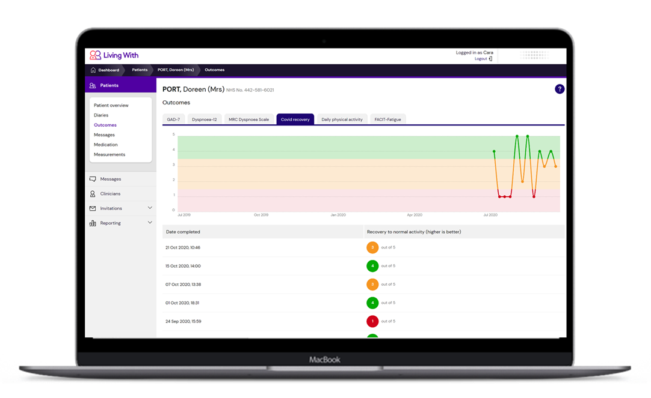
Dashboard

Slide 38
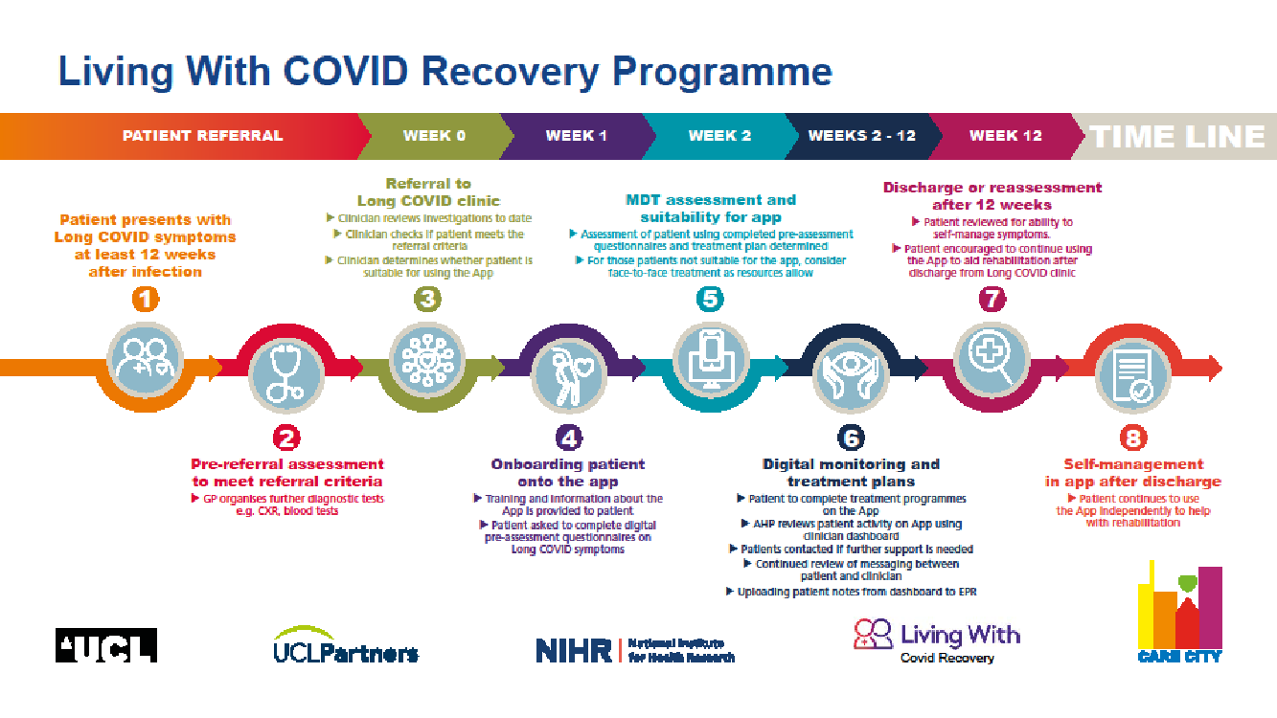

Slide 39
How the DHI can help clinics
Faster and more efficient assessment on new patients
Switch from paper and post to digital questionnaires
Improved care
Real time monitoring of patients in community.
Improved communication with patients.
Appointments, leaflets, updates, Questionnaires
Reduce waiting times
Able to look after more patients. Switch to virtual sessions

Slide 40
Overview of deployment
713 day recruitment period from 4th of August 2020 to July 18th 2022
7239 pts invited (av 10.1 pts a day)
35 different clinics with 19 clinics invited over 100 pts each
5684 pts registered 77.2% (av 8.0 pts a day)
1143 discharged patients 20%
Best clinics
Invited 1008 pts (av 3pts per day)

Slide 41
Just starting to analyse data
Very challenging as set up as service delivery not research
We have lots of missing data and no controls
At a clinic level we are trying to identify and explain the variations we see across clinics in
Uptake (30% difference in registration between clinics)
Engagement (number of App features used)
Adherence (how long patients continue to use the App)
Health inequality differences (variation caused by ethnicity, IMD or Age)
Relationship between HCP engagement and Pt engagement

Slide 42
Clinic variations
Each clinic used the DHI in a different way
Each clinical pathway is different: Many set up with different resources and staff
Type of appointment: F2F, telephone or virtual
Utilisation of features: SMS, questionnaires

Slide 43
Patient engagement
Large difference between clinics in
Percentage of patients that register after being invited
  Large difference in % registered best 90% and worst 60%
Average number of questionnaires completed per patient
  Best clinics average 20 questionnaires per pt in the first month compared to 5
Trying to understand why some clinics were better than others

Slide 44
Early insights
Good clinics had
Integration of the DHI into the clinical pathway
Altered clinical pathway to fit with DHI
Good staff engagement
Clear communication with patients

Slide 45
Why we were successful?
There was a large unmet need in Long Covid
Out team covered a wide range of expertise that complimented each other allowing us to make quick reliable decisions based in minimal information.
We worked closely with all end users to make sure their needs were being met (patients, HCPs and services)
Spread through word of mouth of clinicians

Slide 46
Future
New model of care with digitally augmented clinics
Switch follow up appointments from pre-defined to reactive
Assess and Triage using PROMS before appointments.
Improved communication with patients
Lead to
  Reduced appointments
  Improve patient experience
  Better care
  Higher patient to staff ratio.

Slide 47
HCP feedback
“Would love to manage all rehab patients this way”.
“Really useful to us to manage a much bigger cohort in a shorter period of time. Understand the patient group and who is struggling or need more 1 to 1”.
“Spot people before they crash before they become a total heap …So that is a really proactive way of managing people and as clinicians we love that”.
“From our perspective there are great learning opportunities. We are managing remotely which we have not done before and getting a better understanding of what this patient population need and how they are responding to different treatments. That’s enabled us to teach the whole team how to look after these patients”.

Slide 48
Thanks to
UCL
Prof Elizabeth Murray: Professor of eHealth and Primary Care; Prof Ann Blandford: Professor Human Computer Interactions; Dr Manuel Gomes: Associate Professor in Health Economics; Dr Henry Goodfellow, Academic Clinical Lecturer in eHealth and GP; Dr Fiona Hamilton: Associate Professor in eHealth and GP; Prof Delmiro Fernandez-Reyes: Professor of Biomedical Computing; Prof Fiona Stevenson: Professor of Medical Sociology
Barts
Dr. William Ricketts, Consultant Thoracic surgeon, Dr Paul Pfeffer: Consultant Respiratory Physician; Dr Richa Singh: Consultant Respiratory Physician, Hannah Hylton, Respiratory physiotherapist; Charlotte Foster: Dietitian at Barts Hospital
UCLH, CNWL AND Royal Free
Dr Melissa Heightman: Clinical lead of the COVID follow up service at UCLH and integrated Consultant Respiratory Physician at UCLH; Dr Stuart Linke: Clinical psychologist at Camden and Islington Foundation Trust; and Prof John Hurst: Professor of Respiratory Medicine (UCL) and Consultant Respiratory Physician, Royal Free
Other Research Expertise
Katherine Bradbury: Health Psychologist at Southampton University; Prof William Henley: Professor of Medical Statistics at Exeter University
Living With

Slide 49
Slido
Please scan the QR Code on the screen. This will take you through to Slido, where you can interact with us.
3rd November 2022- 08:00am – 15:30pm – Hatfield’s Conference Centre
Conference hosted by Convenzis Group Limited

Slide 50

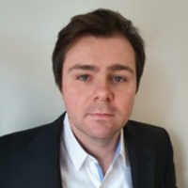
The NHS Telemedicine Conference 2022
Q&A Panel
Professor Bryn Baxendale
Rachel Binks
Dr Goodfellow
Clinical Advisor and Lead, Simulation and Immersive Learning Technologies HEE Technology Enhanced Learning Programme - Health Education England
Nurse Consultant, Digital and Acute Care and Clinical Lead for the Digital Care Hub - Airedale NHS Foundation Trust
NIHR clinical lecturer in digital health and Primary Care - UCL

Slide 51
The NHS Telemedicine Conference 2022
MORNING BREAK, NETWORKING & REFRESHMENTS

Slide 52
The NHS Telemedicine Conference 2022
Chair Morning Reflection
Dr. Dimitris Kalogeropoulos
Senior Independent Adviser, Global Health Innovation Expert
WHO, World Bank, European Commission, UNICEF, Healthcare Industry

Slide 53

The NHS Telemedicine Conference 2022
UP NEXT…

Slide 54
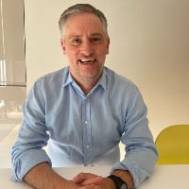
The NHS Telemedicine Conference 2022
SPEAKING NOW
I will be discussing…
“Piota Healthcare Apps”
Chris Elkin
Head of Healthcare
Piota Healthcare Apps

Slide 55
Slido
Please scan the QR Code on the screen. This will take you through to Slido, where you can interact with us.
3rd November 2022- 08:00am – 15:30pm – Hatfield’s Conference Centre
Conference hosted by Convenzis Group Limited

Slide 56
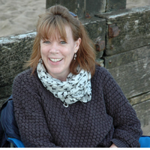
The NHS Telemedicine Conference 2022
SPEAKING NOW
I will be discussing…
“Using Telemedicine to Support acute stroke care in the East of England”
Lynda Sibson
Telemedicine Manager
East of England Stroke Telemedicine Partnership

Slide 57

Acute Stroke Care in the East of England
Using technology to support local decision making
November 2022
Notes:
This PowerPoint presentation will provide an overview of the stroke telemedicine service in the East of England and outline the paramedic stroke telemedicine project.

Slide 58
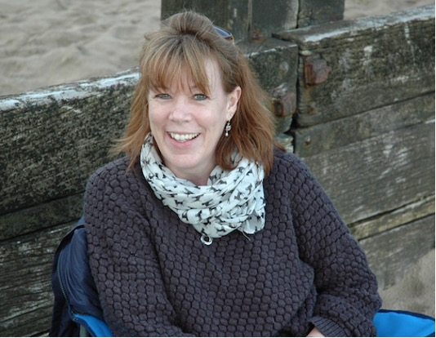
Lynda Sibson
Telemedicine Manager
East of England Stroke Telemedicine Partnership

Slide 59




Current Technology

Slide 60


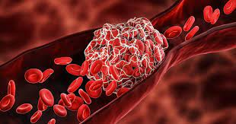


UK stroke statistics
100,000 strokes/year
85% ischaemic strokes
2/3 stroke survivors suffer disability
25% working age

Slide 61
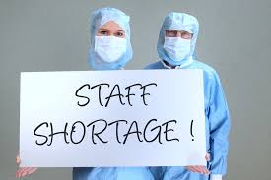





Why telemedicine?
Notes:
There were several factors impeding the number of AIS patients receiving thrombolysis across the region.
As we have an older population –
Lack of Stroke Consultants – there is a UK-wide shortage of Stroke Consultants. Telemedicine was seen as a model for allowing greater access to this limited expert resource
“Tractor Factor’ – some of the regional infrastructure is poor leading to prolonged ambulance run times- up to 45-60 minutes in some areas of the region,
These factors were all relevant as since, at the start of the telemedicine service in November 2010, the license for administering the thrombolysis drug (Alteplase) was 3 hours from symptom onset (Onset to Needle time).
In 2010, many of the region’s hospitals local to the patient were not able to administer thrombolysis. The patient would be assessed at their local hospital, diagnosed with an AIS and require a secondary hospital ambulance transfer to hospital with a Hyper Acute Stroke Unit (HASU). These delays in the pathway frequently resulted in the patient being ineligible for thrombolysis as they were outside the 3 hour timeframe.

Slide 62
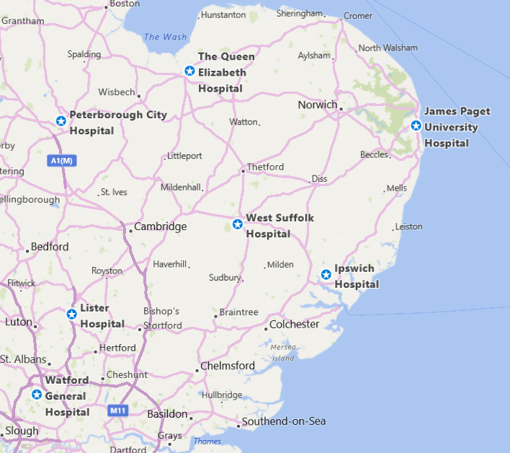
East of England
7,400 square miles
47 miles
1 hr. 22 mins
Pop. 6.2 million
87 miles
1 hr. 43 mins
6,000 strokes/year
58 miles
1 hr. 14 mins
Notes:
The East of England covers 7,500 square miles and is largely rural. The region’s hospitals manage just over 6,000 stroke patients annually.
The travel time between some of the region’s hospitals are highlighted here – these are travel times on a good day!

Slide 63
Stroke Telemedicine timeline
2010
  Service launch
  4 hospitals
2012
  5 hospitals
  Thrombolysis extended
  (IST-3)
2016
  7 hospitals
  Image Exchange Portal
2018
  Paramedic Stroke Mimic Project
  12 consultants
2022/3
  AI
  Additional hospitals
  Virtual Clinics

Slide 64







Provide access to Out of Hours stroke consultant expertise for 7 regional hospitals to support local stroke thrombolysis for acute ischemic stroke

Slide 65



Telemedicine

Slide 66




Radiology Imaging
Notes:
Each hospital trust has a node added to each CT scanner so that radiology images – CTs & CTAs – can be transmitted to our ‘Blue Light’ Institution on Sectra’s IEP network so that they are available via web-based application. This allows the consultants to access high quality radiology images from each Trust safely & scurely

Slide 67



Telecommunications
9 acute Trusts
7 hospitals
2 ISDNs
12 stroke consultants
01223 654704

Slide 68


Managing data & information

Slide 69

Based on current best clinical practice
NICE/RCP guidance
Agreed with all Trusts!
Notes:
This is the regionally agreed Stroke Telemedicine Pathway and is based on national guidelines and evidence-based practice.
Royal College of Physicians (2016) Stroke Guidelines
https://www.rcplondon.ac.uk/guidelines-policy/stroke-guidelines -a copy should be attached to all the telemedicine carts as a quick access guide.
The patient remains the clinical care of their local hospital at all times and therefore any local guidelines – which may be relevant – are followed as necessary in relation to stroke patients.
The Pathway is regularly reviews in light of changing evidence.

Slide 70

Notes:
This traffic light system relates to the suitability of the patient for thrombolysis and again a copy should be attached to every telemedicine cart.
The Relative & Absolute Contraindications (RCIs & ACIs) relate to the thrombolysing agent, Alteplase and are as a guide to assist the local stroke teams to support decision-making in referral.
The RCIs are patient-specific and discussed locally in relation to each patient. In general any patient with an ACI to Alteplase should NOT be referred to the telemedicine service, which is for thrombolysis only. However, patients with an ACI to Alteplase are occasionally referred and this maybe due to the complexity of the patients presenting symptoms.

Slide 71




Current OOH Stroke Thrombolysis Pathway
HASU/CSS
Stroke Nurse
999
ED
Alert Stroke Team
Suspected stroke patient
Stroke – confirm diagnosis & treat
Yes
?Acute Ischaemic Stroke
No
Local/other care
Stroke Consultant
Notes:
This slide outlines the current Stroke Thrombolysis Pathway and we aim to keep the patient at the centre of care.
Most patients present by ambulance following a 999 call – a smaller number self-refer – but as you know, the ED /Stroke Teams are alerted to a potential stroke patient.
The Stroke Nurse Specialists usually lead the initial clinical assessment, arranging the CT scan and contacting the on call Stroke Consultant. Once the patient has had a CT scan, this is transmitted directly to our ‘blue light room’ on the IEP system.
This ensures that CT scans are sent securely to a special online portal, which is accessible by the Stroke Consultant, so that they have an overview of the patient clinically – from physical assessment and radiologically.
Once the diagnosis of AIS is established, and the patient and local team agree the treatment, the patient will received thrombolysis.
None of the teleconsultation is recorded and we gain informed verbal consent from the patients prior to the teleconsultation commencing.

Slide 72




Key outcome data*
Median DTN – 74 mins
(IQR Range 28 mins)
Median OTN – 2 hrs. 53 mins (IQR Range 56 mins)
49.2%
46.4%
Onset to ED – 1 hr 42 mins
ED to teleconsultation – 52 mins
Teleconsultation time - 30 mins
* Median data from Stroke Telemedicine Audit Forms (Nov 2010 – Sep 2022) & SSNAP database

Slide 73


Slide 74

UEA Health Economic Analysis
Total NHS cost savings associated with telemedicine
£482.4k (1yr)
£471.3k
(5 yr)

Slide 75
Stroke Telemedicine Health Economic Analysis
”A stroke care pathway with telemedicine is both cheaper and provides better outcomes, providing a cost-effective method for delivering stroke care in the region”
UEA Economics Consulting/UEA, 2019

Slide 76

Key outcomes
telemedicine via a hubless horizontal model provides a ‘clinically effective and safe method for delivering hyperacute stroke thrombolysis’
Improved door-to-needle times were offset by
a concerning rise in prehospital timings
‘telemedicine may benefit in-hospital hyperacute stroke care, improvements across the whole stroke pathway are essential’

Slide 77




Telemedicine implementation
People not technology
Change management
Education & training
Leadership
Notes:
Some of the lessons learned along the way….
We have found the the technology is not important. Provided the technology is robust and easy to use – you really shouldn't notice that it’s there. Similar to you using FaceTime/Skype/Zoom – they are easily accessible and should work seamlessly with clinical practice.
Some of the barriers have been people – as humans we don’t like change very much and this is a different way of practicing. But we have found that as innovators – the paramedics who have been using the telemedicine system so far have found it really useful.
Education and training are key – clearly during the current time we are unable to deliver this learning face-to-face which would have been our preference – we’re doing the next best thing and can establish some online, more interactive sessions as needed.

Slide 78



Looking ahead
Artificial Intelligence
Telerehabilitation
Virtual
Clinics

Slide 79

It’s a journey!
Notes:
Like most journeys – be involved in a project can be long, sometimes arduous and trying but it’s about what we learn on the journey as well as this destination.
The ambulance Trust are going to be looking at a range of clinical activities using other videoconferencing software and clinical specialties.
EEAST are the first ambulance Trust to eb involved in telemedicine in the UK so there are some exciting times ahead!

Slide 80
Thank you for listening
Lynda Sibson
Telemedicine Manager
East of England Stroke Telemedicine Stakeholder Partnership
For further information contact:
Lynda.Sibson@nhs.net
Any questions?

Slide 81
Slido
Please scan the QR Code on the screen. This will take you through to Slido, where you can interact with us.
3rd November 2022- 08:00am – 15:30pm – Hatfield’s Conference Centre
Conference hosted by Convenzis Group Limited

Slide 82


The NHS Telemedicine Conference 2022
Q&A Panel
Lynda Sibson
Chris Elkin
Telemedicine Manager
East of England Stroke Telemedicine Partnership
Head of Healthcare
Piota Healthcare Apps

Slide 83
The NHS Telemedicine Conference 2022
NETWORKING &
LUNCH

Slide 84
The NHS Telemedicine Conference 2022
Chair Afternoon Address
Dr. Dimitris Kalogeropoulos
Senior Independent Adviser, Global Health Innovation Expert
WHO, World Bank, European Commission, UNICEF, Healthcare Industry

Slide 85

The NHS Telemedicine Conference 2022
SPEAKING NOW
I will be discussing…
“The role of the SME and Innovation to the NHS”
Neil Roberts
CEO
SEHTA

Slide 86

The NHS Telemedicine Conference 2022
Role of the SME and Innovation to the NHS
Neil Roberts, CEO, SEHTA
Thursday 3rd November 2022
©SEHTA 2022

Slide 87
SME’s in Healthcare
With 3,860 companies, HealthTech is the largest employer within UK Life Sciences, and 89% of its businesses fall into the SME category
Source: ABHI
©SEHTA 2022

Slide 88

Aim - to Improve Healthcare
©SEHTA 2022

Slide 89
The Opportunity
NHS – Long Term Plan
Making sure everyone gets the best start
in life
Delivering world class care for major health problems
Supporting people to Age Well
©SEHTA 2022

Slide 90





Understanding the Ecosystem
©SEHTA 2022

Slide 91

Competitive behaviour
©SEHTA 2022

Slide 92

Product – Life cycle of use
©SEHTA 2022

Slide 93

Selection and Adoption of Innovation
©SEHTA 2022

Slide 94

©SEHTA 2022

Slide 95

How best to work together
©SEHTA 2022

Slide 96

Contact Details
Neil Roberts
neil.roberts@sehta.co.uk
07875 704328
www.sehta.co.uk
©SEHTA 2022

Slide 97
Slido
Please scan the QR Code on the screen. This will take you through to Slido, where you can interact with us.
3rd November 2022- 08:00am – 15:30pm – Hatfield’s Conference Centre
Conference hosted by Convenzis Group Limited

Slide 98

The NHS Telemedicine Conference 2022
SPEAKING NOW
I will be discussing…
“Listening in & changing practice - Lessons learnt from our experience of proactive clinical assurance of remote GP COVID-19 consultations”
Dr. Kathy Smith
GP Auditor for CCAS at South Central Ambulance Service NHS Trust / Interim Medical Lead for GP Workforce Solutions
NHS SCW CSU

Slide 99


The 111/CCAS experience:
Listening in and changing practice
NHS Telemedicine Conference, 3rd November 2022
Dr Kathy Smith
CCAS Legacy team - National Covid-19 Response Services (NPHERS),
South Central Ambulance Service NHS Foundation Trust
Interim Medical Lead for GP Workforce Solutions,
NHS South Central and West CSU
Notes:
Hello and thank you for inviting me to talk to you about our experience of GP consultation review, as part of clinical assurance, for the COVID-19 Clinical Assessment service
My name is Kathy Smith and I am a GP and auditor with the CCAS legacy team which is part of the National COVID-19 Response Services, hosted by South Central Ambulance Service.

Slide 100
Introduction to Covid-19 Clinical Assessment Service (CCAS)
  Background
  Operational challenges
  Clinical challenges
Proactive clinical assurance process
  RCGP Urgent and Emergency Care Call Audit Toolkit
  Audit process
  Audit outcomes
Lessons learnt
Recommendations for primary care
Notes:
So We would describe what CCAS was, and its role as part of the national covid-19 response. Specifically, we will be discussing lessons learnt from CCAS-1.
We will touch upon some of the unique challenges faced by CCAS, both operationally and clinically and how our clinical assurance work enabled us to address some of these challenges
We will describe an aspect of our clinical assurance work which involved consultation review and is referred to as ‘audit’ or call audit.

Slide 101
Source: NHS 111 MDS Time Series to March 2021, IUCADC including NHS 111 to March 2022 and IUC CRS data from Feb 2020 to Mar 2022
Notes:
This graph shows the call volumes from March 2020 to May 21. As you can see there has been a general increase in demand to the 111 services since the start of the pandemic.
And in green part of the bar chart, you can see the additional calls taken by the Covid Response Service from March 2020 to through to March 2021 when the front-end service was stood down.

Slide 102
Source: https://www.england.nhs.uk/statistics/statistical-work-areas/nhs-111-minimum-data-set/nhs-111-minimum-data-set-2020-21/
Notes:
Can we start by seeing a show of hands from the audience – Who has heard of CCAS?
Thank you. We hope that by the end of this presentation you will have learnt something about our role as part of the National COVID Response Service.
Firstly, This graph shows the average number of calls per day to the 111 services since in 2015. In 2019 the services were receiving just over 50,000 calls per day. But as you can see there was a dramatic rise in call volumes in in early 2020.
This surge in demand required rapid response and innovation.

Slide 103
Operational challenges

Slide 104
Evolution of the Covid-19 Clinical Assessment Service (CCAS)
13th March 2020
WHO Level 4
Pandemic
announced
19th March 2020
Retired GPs allowed to re-register Coronavirus Act
26th March 2020
First GP application received
23rd March 2020
First Lockdown announced
31st March 2020
First CCAS patient
Notes:
As the numbers of COVID-19 cases rose, capacity to deal with this increase in demand on 111 was supported by the rapid stand-up of CCAS. ,This was commissioned by NHS England as the clinical element of the response, Set up South Central and West Commissioning Support unit and hosted by South Central Ambulance Service NHS FT as part of the Pandemic flu response programme.
It was just 17 days between the date of the pandemic declaration by the World Health Organisation to the date of the first patient consultation which highlights the acute operational challenges of rolling out a service at pace .
Initially Retired GPs were a significant part of our workforce responding to assist their primary care colleagues and to be joined later by a large cohort of GPs who were previously working as locums, and primary care colleagues who had capacity. Another unique feature of the CCAS workforce were the GPs who were shielding and would otherwise have not been able to contribute clinically.
It is worth noting over the first 3 months of the pandemic almost 1500 GPs were onboarded to the service.

Slide 105
March 2020
April 2020
June 2020
First GPs onboarded to CCAS
Laptops sent out to GPs
First peak in COVID-19 cases
First Nightingale Hospital launched in London
May 2020
24 hr service launched
NICE Guideline [NG165] COVID-19 rapid guideline published
RECAP and Principle trial patient recruitment via CCAS
July – Aug 2020
Video consultation tool launched
Electronic Prescribing facility
Sep - Nov 2020
Second peak in COVID cases
Second National Lockdown
SMS messaging launched
Coronavirus (COVID-19) Breathlessness Triage Support Tool published (NHS Digital)
Notes:
If we run you through some key moments on this 6 month CCAS timeline – you can see some of the challenges we faced, and the need for the service to be agile and adapt at pace to developments such as changing guidance.
It’s important to remember that at this time COVID was largely an unknown entity; we knew it was an atypical pneumonia with high mortality rates from the information coming out of the Chinese experience. But We had no textbooks or specialists to call upon for advice. There were also technical challenges in that when we first started the GPs did not have the ability to prescribe or conduct video consultations. But as you can see these were introduced later to meet this need.
Having a national platform through which a large number covid patients were assessed, also enabled us to recruit patients for the Principle and RECAP trials.
(3 mins 10 speaking time)

Slide 106
The Patient Journey
Patients with symptoms of Covid-19
NHS 111
Cohort 1:
Urgent Hospital Admission
Cohort 2:
Referred into CCAS
Cohort 3:
Self-isolate, self-care advice and worsening and safety-netting advice
Re-assessed as either:
Cohort 1
Primary care review e.g. ‘hot hub’
Cohort 3
Covid Response Service (CRS)
Notes:
Kathy
Here we share NHSE's pathway for patients with suspected COVID symptoms
The general public were advised to either call 111 or use the 111 online tool. And through these routes be triaged according to self reported symptoms.
Patients were divides into 3 cohorts, and cohort 2 were the patients requiring further clinical assessment, or specialist advice, and these were passed on to the CCAS queue to await a call back from a GP.

Slide 107
Clinical challenges

Slide 108

Source: https://digital.nhs.uk/services/covid-19-clinical-triage-support-tool/covid-19-breathlessness-triage-support-tool/covid-19-breathlessness-triage-support-tool-guidance

Slide 109

Source: BMJ 2020; 368 doi: https://doi.org/10.1136/bmj.m1182 (Published 25 March 2020)

Slide 110
Proactive Clinical Assurance

Slide 111
5738 call audits
1500 GPs
0.5m GP calls
60% self-care
Clinical Governance Team
30 GP Auditors
Medical Governance Lead(s)
Clinical Assurance Director
Notes:
This was the clinical governance team set up, we were a large team with a wide skill mix
30 GP auditors, supported by a Clinical Governance Team wrapping around the whole process providing consistency and support
2 Joint Clinical Governance Medical Leads, under the guidance of a Clinical Assurance Director
1.6 million calls offered by the Covid Response Services
547 064 calls were handled by CCAS-1 and 5738 of these consultations were audited
1% of CCAS-1 GP consultations sampled for clinical assurance

Slide 112


Notes:
We had the advantage in that Our first Medical Governance Lead, was part of the original working group who had developed the RCGP Urgent care audit process
So We used the RCGP toolkit as a base for consultation reviews.
The audit tool was adapted several times to better measure key quality areas as we learnt more. We added criteria to reflect covid management such as the presence of adequate testing and isolation guidance, appropriate covid risk assessment, and the risk of transmission in terms of safety to others.,

Slide 113
Audit process
Calls selected at random
Electronic written notes and call events reviewed
Audio call record reviewed
Audit feedback form completed
Written +/- verbal feedback
Escalation if required and re-audit timeframe set

Slide 114
Assessment domains – adaptation of RCGP Urgent Care Audit toolkit
Elicits reason for the call
Makes appropriate management decisions
Identifies Emergency Situations
Takes an appropriate history
Carries out an appropriate assessment
Draws conclusions
Correctly fills in documentation
Safeguarding
Use of IT
Empowering behaviour
Adequate safety-netting
Develops Rapport
Appropriate prescribing
Notes:
using both the audio and written record had some advantages in that the auditor could better understand the clinical state of the patient –
Hearing someone who is unable to complete sentences allowed appreciation of the acuity of the illness which may explain a truncated consultation or brief written notes.
You can hear a patient’s agreement and satisfaction with the quality of explanation provided and get an idea of their level of understanding.
We found the written record did not always accurately reflect the audio recording.. In reviewing both, we were able to pick up discrepancies and could feedback when a GP had written something that had not been said,
Conversely A GP with sparse written safety-netting notes did not necessarily reflect a poor consultation if they could be heard to give very thorough advice on the call.

Slide 115
Criteria within domains
Elicits reasons for the call
A. Introduces themselves by name and organisation
B. Patient states (or re-states) their name and two other demographic details.
C. Confirms current location
D. Seeks permission to speak to third party where necessary
E. Gives a good explanation of the process
F. Clearly Identifies presenting symptoms
Identifies Emergency Situations
A. Asks appropriate questions to identify or exclude [or suggest] such situations
B. Appropriate use of ILTC protocols
C. Phrases questions in a way the caller can understand
D. Quickly establishes the need to respond to a serious or emergency situation and acts accordingly
Takes an appropriate HISTORY
B. Elicits social history (including household members, social contacts, work and smoking)
C. Uses GP connect with permission to access Summary Care Record.
D. Identifies relevant PMH/DH [including drug allergy]
E. Identifies Covid risk factors e.g. exposure risk, obesity, ethnicity and LTCs.
A. Explores symptoms and symptom progression (considering COVID, current illness and co-morbids)

Slide 116
Criteria within domains
Carries out appropriate ASSESSMENT
A. Targeted information gathering (or use of decision support if available) to aid decision making
B. Links findings to history
Draws CONCLUSIONS that are supported by the history
A. Constructs appropriate diagnosis or differential based on the history / identifies appropriate 'symptom cluster'
B. Streams / Refers patient appropriately
Appropriate MANAGEMENT and ADVICE following assessment
A. Decisions conform to clinical guidelines (with exceptions clearly justified)
B. Gives appropriate advice on escalation e.g. asthma, DMARDS, steroids pregnancy and diabetes
C. Gives appropriate testing & isolation advice, including for negative tests (for patient and household)
D. Decisions are safe for the patient and the wider public and LTCs.

Slide 117
Criteria within domains
Correctly fills in appropriate DOCUMENTATION
A. Documents information clearly including patient advice
B. Written record matches audio record
Appropriate PRESCRIBING behaviour
A. Generics used [unless inappropriate]
B. Formula-based [where available]
C. Follows evidence base or recognised good practice
D. Appropriate use of e-prescribing
Displays adequate SAFETY-NETTING
A. Clearly gives advice about when and who to call back
B. Records advice given (worsening instruction)
Notes:
using both the audio and written record had some advantages in that the auditor could better understand the clinical state of the patient –
Hearing someone who is unable to complete sentences allowed appreciation of the acuity of the illness which may explain a truncated consultation or brief written notes.
You can hear a patient’s agreement and satisfaction with the quality of explanation provided and get an idea of their level of understanding.
We found the written record did not always accurately reflect the audio recording.. In reviewing both, we were able to pick up discrepancies and could feedback when a GP had written something that had not been said,
Conversely A GP with sparse written safety-netting notes did not necessarily reflect a poor consultation if they could be heard to give very thorough advice on the call.

Slide 118
Additional criteria
(if applicable)
Did the clinician address any potential SAFEGUARDING issues?
A. Do the notes demonstrate an awareness of safeguarding issues (where relevant)?
B. If safeguarding issues were suspected was the patient referred to the appropriate service?
C. If an injured child or vulnerable adult; did the clinician explore the possibility of intentional injury?
Makes appropriate use of IT/Protocols/Algorithms
A. Adequate data recording
C. Use of IT tools and telephony where available (Care advice, DoS, Appointments and Prescribing)
D. Use of SMS messaging with appropriate URLs
E. Keeps patient on the line until DOS completed for referrals
F. Appropriate referral to another service if required (service and time frame)

Slide 119
Additional criteria
(if applicable)
Displays EMPOWERING behaviour
A. Identifies patients concerns (health beliefs)
B. Involves patient in decision-making
C. Use of self-help advice [inc. signpost to appropriate websites]
D. Responds appropriately to caller requests for information
Develops RAPPORT
A. Demonstrates good listening skills
B. Communicates effectively [including use of English]
C. Conducts themselves in a professional manner

Slide 120
Audit outcomes

Slide 121
Data previously presented by K Smith for SCAS to The Nuffield Trust RBD2 quality and safety of remote consultations workshop September 2022
Notes:
Calls that were marked as a change in practice, were reviewed in the buddy audit system to allow for difference in risk holding between GPs to be considered. We found that change in practice calls would often have multiple issues and if significant concerns were identified these were escalated accordingly.
Acceptability was really important because we didn’t want to undermine the GPs’ confidence. We were there to engage with GPs and support them acknowledging that they were working in challenging conditions. Furthermore, It was a difficult environment considering the rapid switch to remote home working which was new for most of the workforce.

Slide 122
Lessons learnt

Slide 123
Appreciate the wide variation in consultation styles
Share good practice
Emphasis on the commentary and qualitative feedback
Develop educational resources
Notes:
Thank you,
So what did we learn.
Whilst this was set up as part of clinical assurance, we found many unintended benefits.
The emphasis on a regular GP-to-GP conversation allowed us to capture feedback from the workforce and contemporaneously improve the training offered and educational support provided. There were also service access issues highlighted and addressed.
By listening in to consultations we could share good practice that we had heard for example Explaining COVID illness succinctly or negotiating isolation and testing advice in a way that avoided jargon.
As GPs we often have our own spiels developed over time, through conversations with patients and colleagues. For our remote GPs that ‘corridor chat’ was initially lacking so the feedback conversation was a mechanism through which we could share this good practice.
The auditors regularly met to discuss feedback received and were able to develop educational resources based on the feedback. These Included our CCAS Safe consultation framework, Tips and pitfalls document as well as Webinars, podcasts, and newsletter updates.

Slide 124
87.5% of GPs reported changing their practice in response to their audit feedback
Data previously presented by K Smith for SCAS to The Nuffield Trust RBD2 quality and safety of remote consultations workshop September 2022
Notes:
So how did we change practice?
We had a process for managing calls with concerns. Depending on these concerns the auditor team could offer coaching, case discussions and/or more intensive audit. This was very much done on a case-by-case basis and as mentioned before most calls did not require such measures.
Realizing that proactive consultation review for quality was not standard practice in primary care consultations , we took the opportunity of the exit questionnaire to survey the GP experience. Overall, we were very pleased find that of those who responded 87.5% had reported changing an aspect of their practice following the audit feedback.

Slide 125
The audit process felt…
Data previously presented by K Smith for SCAS to The Nuffield Trust RBD2 quality and safety of remote consultations workshop September 2022
Notes:
We also want to share the positive response to the feedback process. The GPs felt it was supportive, educational, useful for their appraisals and CPD and reassuring in that they were doing the right thing.

Slide 126
Application beyond CCAS
Data previously presented by K Smith for SCAS to The Nuffield Trust RBD2 quality and safety of remote consultations workshop September 2022
Notes:
We have shown that this type of performance review is acceptable and valued by both GPs and their organizations
In view of the increasing volume of remote consultations in health care, and the accessibility and ease to which calls can be recorded, should we be using this proactive approach for quality improvement beyond urgent care?
As you can see the GP surveyed would welcome consultation review in future practice.

Slide 127
I loved the detail. The best feed back I have ever had….overall a very positive experience
Confirmation that my management is safe and I should continue working in the same way, appreciation and endorsement
Extremely pleasant, thorough; pedantic at times, but sometimes with good reason
Being able to be helped to do things better in a formative and supportive way. Auditors sharing good practice
I had never had my consultations peer reviewed in over 20 years of GP - very useful feedback mostly…
Notes:
So we have also included some positive comments here to reflect how acceptable and supportive our GPs found this process.
The ability to have a one-to-one feedback session with a GP peer who had listened to your clinical encounter was valued.
We want to emphasise that this process was not just about clinical assurance, but it was about being part of a learning organisation. It was about culture, values and attitudes towards improving the patient experience and providing high quality care.

Slide 128
What next?
Recommendations for Primary Care

Slide 129
Potential for wider primary care approach to peer review of performance and clinical quality
In the context of neighbourhood PCN teams this could be a valuable quality improvement process;
Local clinical assurance
Support for the updated GP appraisal model
Potential improvements in retention and recruitment of GPs
Improvement in staff morale and a sense of value to the organization
Consider adoption as part of performance review by regulators and commissioners since the audio record gives us greater insight compared to notes review alone
Disseminating our learning
  Quality assurance of remote clinical assessments in the NHS - The Lancet
  Safety netting in the COVID-19 Clinical Assessment Service | British Journal of General Practice (bjgp.org)
Notes:
In conclusion, we feel a similar process could be introduced within the context of neighborhood teams for quality improvement.
As GPs seem to value being part of a supportive organization, we feel further work should be completed to understand if this could be beneficial to wider recruitment and retention of GPs.
We welcome discussion with other providers on the sharing of call audit outcomes and approach to quality review – we have had a number of discussion with other providers to date – colleagues who have reached out following our letter in The Lancet.
Link to lancet letter in the end

Slide 130


Thank you
Notes:
14-15 max slides

Slide 131
Acknowledgements
The COVID-19 Clinical Assessment Service (CCAS) was commissioned by NHS E/I and created by the NHS South, Central and West Commissioning Support Unit as part of the National Pandemic Flu Service and was hosted and managed by the South Central Ambulance Service NHS Foundation Trust (SCAS).
CCAS would not have been possible without the innovation, dedication and collaboration across stakeholders and their Operations, Human resources and Clinical teams.
We would like to specifically thank our colleagues for their assistance and support with this presentation:
Enid Povey, Carol Rogers, Ruth Allanson, Prof Helen Young, Laura Calow, Caron Brittan and Victoria Dooley
With additional thanks to;
Lynne Heald, Kathy Agrebi, Sue Tucker, Janet Crowe and the many others in the Delivery teams
Dr Jean Challiner, Dr Sarah Kay, Lesley Selfe, 30 GP Auditors and our Clinical Governance team

Slide 132
Slido
Please scan the QR Code on the screen. This will take you through to Slido, where you can interact with us.
3rd November 2022- 08:00am – 15:30pm – Hatfield’s Conference Centre
Conference hosted by Convenzis Group Limited

Slide 133
The NHS Telemedicine Conference 2022
Q&A Panel
Dr Kathy Smith
GP Auditor for CCAS at South Central Ambulance Service NHS Trust / Interim Medical Lead for GP Workforce Solutions
NHS SCW CSU

Slide 134
THANKS FOR ATTENDING
The NHS Telemedicine Conference 2022

Slide 135









REGISTER FOR OUR UPCOMING EVENTS!

